Slide 1

Corpora in Legal Translation: Practical Applications
Dr hab. Łucja Biel
Institute of Applied Linguistics
University of Warsaw
l.biel@uw.edu.pl

Slide 2
Corpus
A body of language representative of a particular variety of language or genre which is collected and stored in electronic form (for the purpose of linguistic analysis)
(McEnery et al.)

Slide 3
Translation-driven corpora
Monolingual comparable corpora contain:
(1) a corpus of translations
(2) a corpus of texts created spontaneously in the same language (nontranslations)
A parallel corpus - source texts aligned with their target texts; it may be bilingual or multilingual and bi-directional
translation memories as ‟a specific type of dynamic parallel corpora” Zanettin (2014: 179)

Slide 4
Use of corpus tools by translators
In general, translators are not familiar with methods of working with corpora (but depends on a country)
Bowker (2004: 13) “the uptake of corpora in the world of professional translators appears to have been considerably slower”
Varela-Vila (2009), Pastor & Alcina (2009: 13) → corpora are increasingly more popular
Gallego-Hernandez (2015) 526 respondents from Spain, 48% of which use corpora (sometimes, often, very often)
Aurelie Picton et al. (2015) 200 respondents from Switzerland with 64% using corpora, 92% using electronic texts as resources, 82% using TM, 56% using concordancers
What do we mean by a corpus? (cf. Picton et al. 2015)

Slide 5
National Corpora
BNC - British National Corpus - http://www.natcorp.ox.ac.uk/
COCA – Corpus of Contemporary American English http://corpus.byu.edu/coca/
NKJP – Narodowy Korpus Języka Polskiego, 2012 - http://www.nkjp.pl/

Slide 6
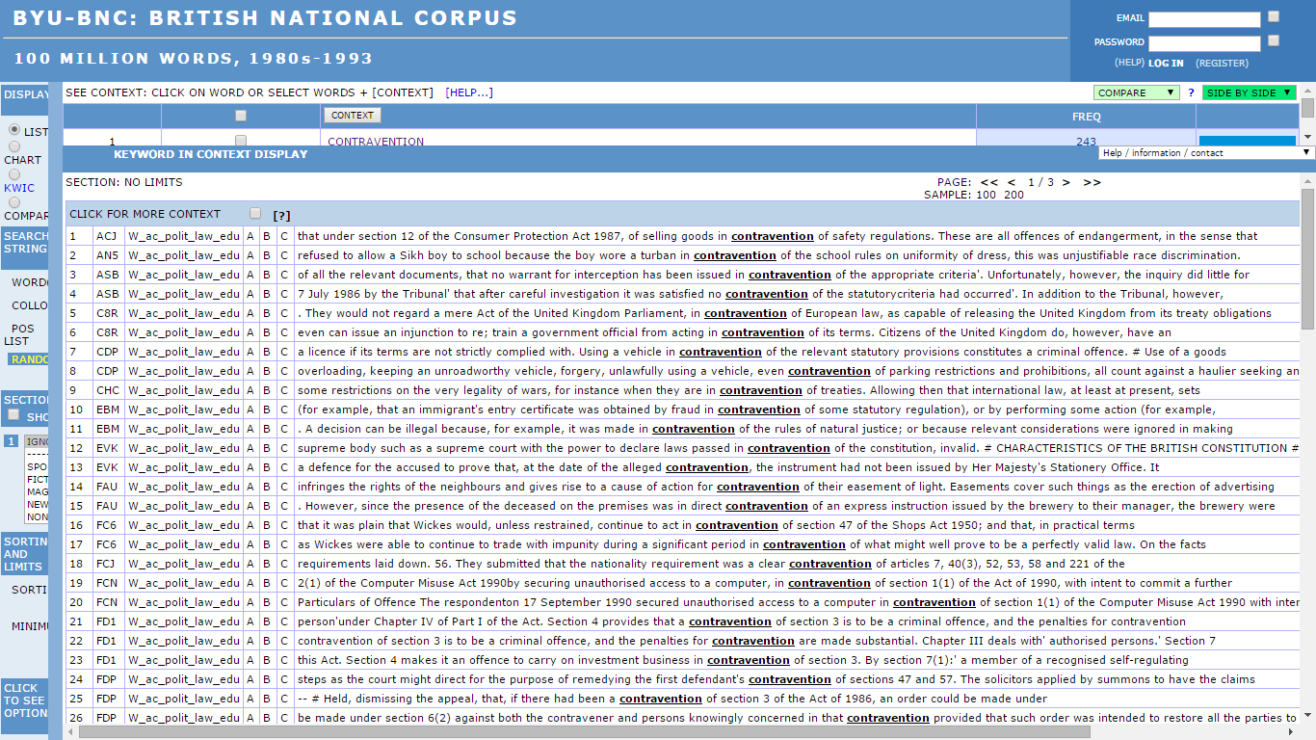
BNC - Brigham-Young University

Slide 7
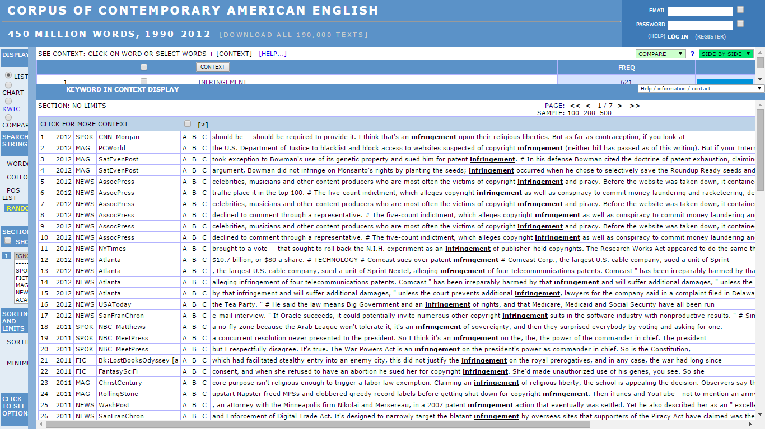
Notes:
The freely searchable 450-million-word Corpus of Contemporary American English (COCA) is the largest corpus of American English currently available, and the only publicly available corpus of American English to contain a wide array of texts from a number of genres.

Slide 8
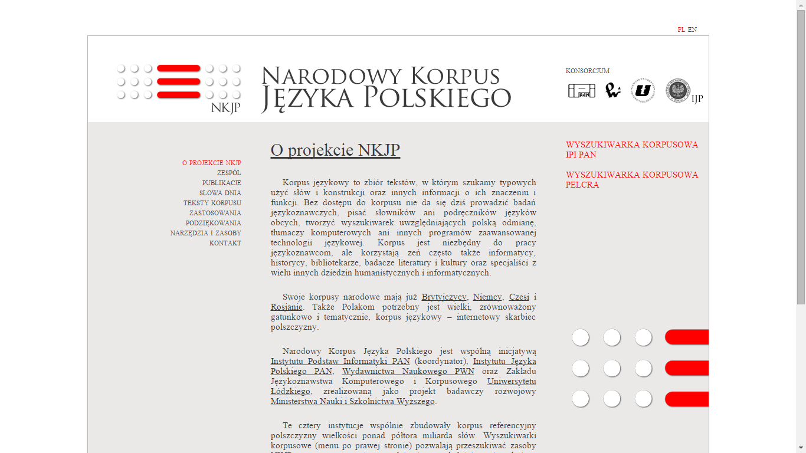
NKJP

Slide 9
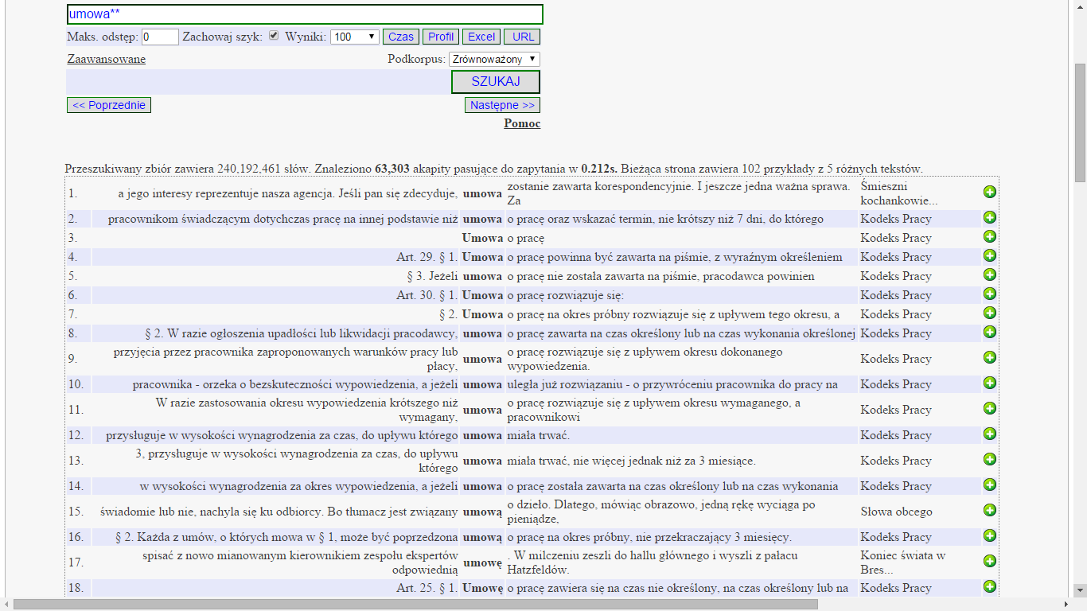

Slide 10
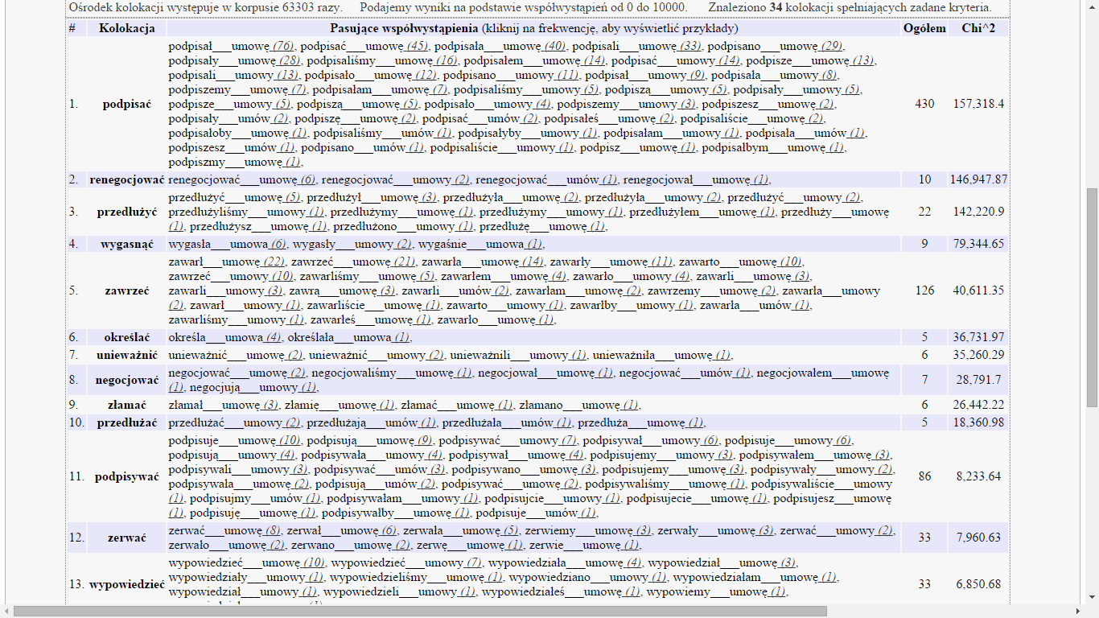

Slide 11
Nowa generacja słowników
Słowniki (ogólne) opracowane na korpusach
Słowniki kolokacji
Mirosław Bańko – Słownik dobrego stylu, czyli wyrazy, które się lubią. PWN

Slide 12
Availability of legal corpus tools
Relatively little efforts devoted to the development of corpus-based tools intended to assist legal translators in their work
limited corpus resources , in particular for lesser used languages
limited accessibility of corpus resources
confidentiality of legal texts and related corpus design limitations → legicentrism
lack of integration of corpus tools with CAT tools

Slide 13
Examples of legal corpora (EN)
BoLC Bononia Legal Corpus http://corpora.dslo.unibo.it/BoLC/BOLCCorpQueryENG.html (UK Acts of Parliament)
JRC Acquis – Multilingual Parallel Corpus http://ipsc.jrc.ec.europa.eu/index.php?id=198
DGT Acquis 2004-2011 https://ec.europa.eu/jrc/en/language-technologies/dgt-acquis
DCEP Digital Corpus of the European Parliament https://ec.europa.eu/jrc/en/language-technologies/dcep
The Old Bailey Corpus – a balanced subset of the digitalised proceedings from 1720 to 1913 http://www.uni-giessen.de/oldbaileycorpus/search.html, 14m words
Cambridge Corpus of Legal English http://www.cambridge.org/gb/elt/catalogue/subject/custom/item3646600/Cambridge-English-Corpus-Cambridge-Corpus-of-Legal-English
More information Pontrandolfo, G. (2012) ‟Legal Corpora: an overview” Rivista Internazionale di Tecnica della Traduzione 14, pp. 121-136.

Slide 14
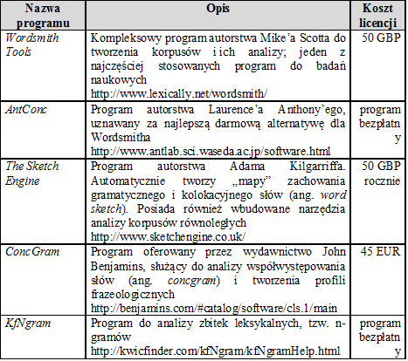
Oprogramowanie

Slide 15
PLC – Polish Law Corpus
PLC (Korpus Polskiego Prawa) -755 ustaw; 6,8 mln słów
KP/PLC (kodeksy, ustawy-prawo) – 50 ustaw, 1,3 mln słów
http://www.eurofog.eu/korpusy/

Slide 16
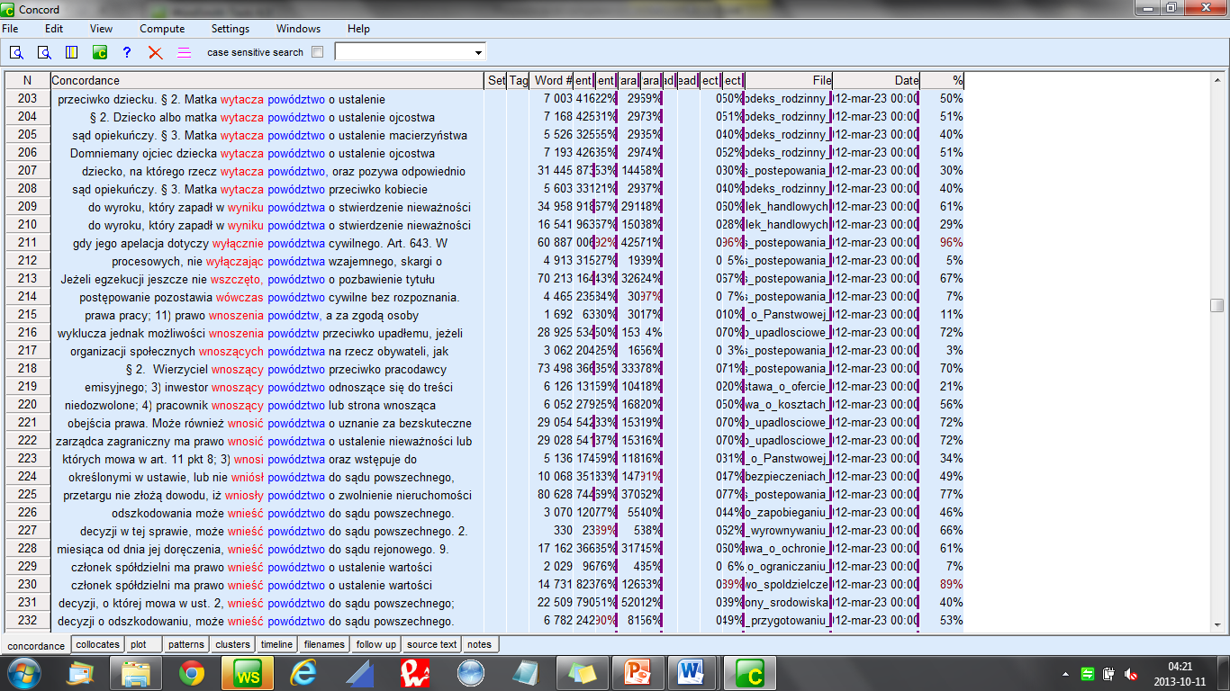
Concordances: collocates of powództwo

Slide 17
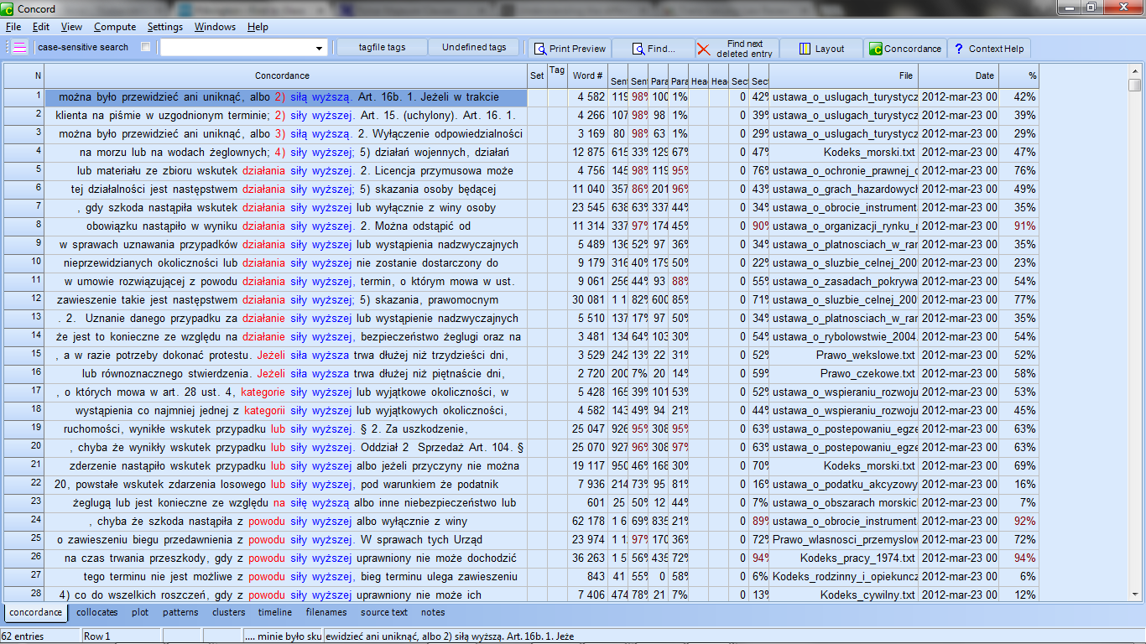

Slide 18
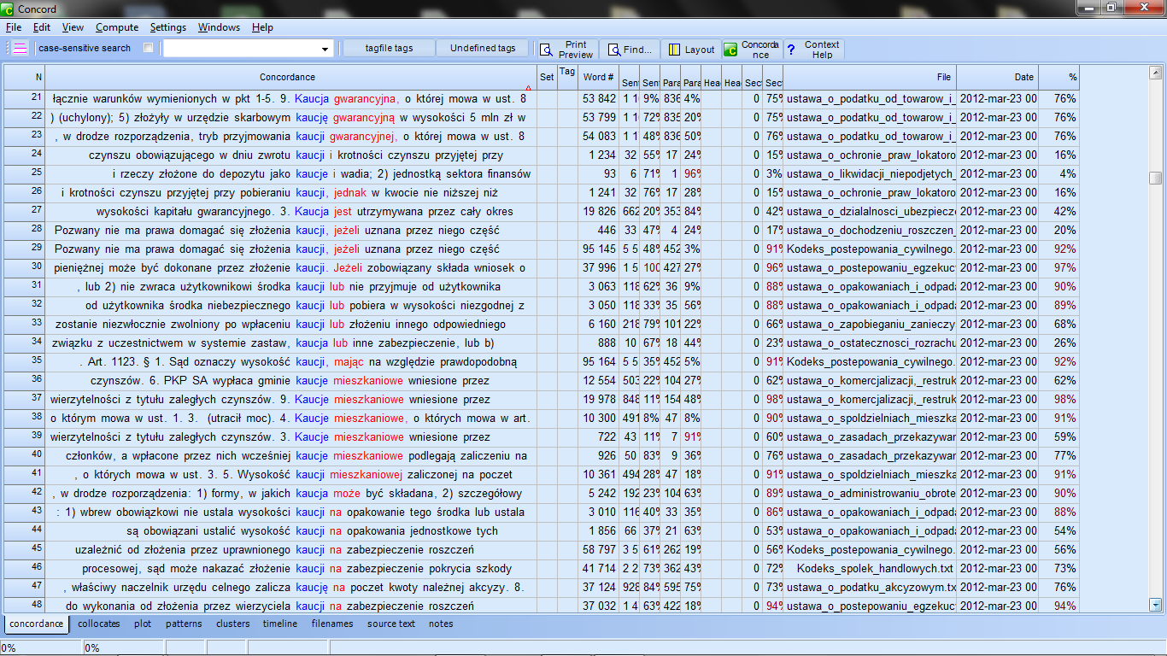

Slide 19
Advantages of corpora
help raise awareness of TL conventions and help imitate how lawyers write
help produce more natural translations, translations which use patterns which are not only possible but also typical of legal TL
more nuanced terminology/phraseology work

Slide 20
DIY/ad hoc corpora
DIY / ad hoc corpora (Bernardini & Zanettin 2000, Beeby et al. 2009), disposable corpora (Varantola 2000)
Legal DIY corpora – J. Scott (2013) ‘reliability’, ‘fitness for purpose’ and ‘authoritativeness’ rather than representativeness; a small genre-based corpus built quickly in e.g. 20 minutes to complete an assignment
A procedure: Defining parameters; collecting corpus material, manual assessment, OCR/batch conversion, use in translation
DIY/ad hoc corpora a powerful tool but more structured, representative and integrated resourced are needed
Because of time pressure, translators want to use corpora that are available and for free

Slide 21
Recent developments:
advanced corpus-based tools

Slide 22
Qualetra project
a consortium led by KU Leuven (Hendrik Kockaert) on training, assessment, certification and accreditation of legal translators in criminal proceedings
A corpus of 63 essential documents, related to fraud, drugs trafficking and theft, as understood by Directive 2010/64/EU (3 documents x 3 offences x each consortium language);
Used for generic analysis to create a termbase and templates with a view to improving the quality of legal translation + a reference corpus
http://www.eulita.eu/qualetra

Slide 23
JudGENTT
JudGENTT, a web platform with documentary, textual and terminological resources for the translation of court documents, developed by the GENTTT (Textual Genres for Translation) Research Group, based at the Department of Translation and Communication at the Universitat Jaume I in Spain (http://www.gentt.uji.es/)
More information: Anabel Borja Albi (2013) ‟A genre analysis approach to the study of the translation of court documents.” Research Models and Methods in Legal Translation, LANS-TTS 12(2013), https://lans-tts.uantwerpen.be/index.php/LANS-TTS/article/view/235/202

Slide 24
TermWise
Corpus-based Terminological Support for Dutch-French Legal Translation
An extension to a CAT-tool and cloud-based database ("Term&Phrase Memory”) based on a big parallel corpus harvested from The Belgian Official Journal, developed for legal translators at the Belgian Federal Ministry of Justice with statistical knowledge acquisition algorithms; to be integrated into a CAT.
one-click access to equivalents of terms and expressions (n-grams) in context from official translations, ranked by relevance according to the similarity to the ST; if accepted, the equivalent is copied to the TT pane.
Heylen, Steurs and Kockaert (2015); Heylen et al. (2014)

