Slide 1
Podstawowe terminy księgowo-finansowe sprawiające szczególną trudność w przekładzie
Anna Setkowicz-Ryszka

Slide 2


Rozgrzewka
Bilans według stanu na dzień 31 grudnia 2015 r.
Kredyt w kwocie 200,000 zł
A loan of PLN 200,000
Współczynnik zwrotu z kapitału w wysokości 50 %
ROE of 50 %
Odpis z tytułu trwałej utraty wartości
impairment / impairment loss

Slide 3
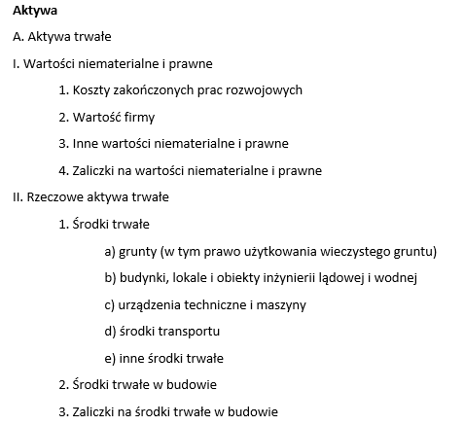
Bilans (sprawozdanie z sytuacji finansowej 0d 2007)

Slide 4
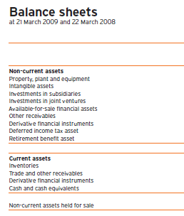
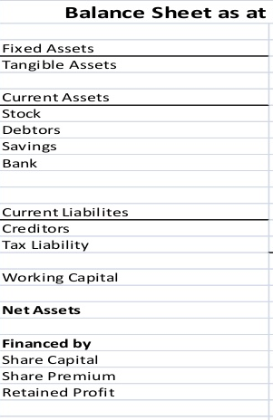
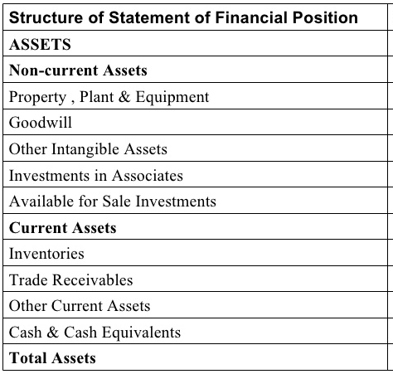
Balance sheet (statement of financial position)

Slide 5
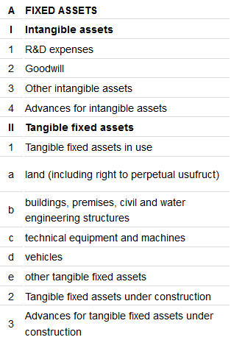
Problem: brak trzeciego poziomu klasyfikacji
Inna możliwość:
Non-current assets / noncurrent assets
…
II. PP&E / Tangible assets
1. Existing PP&E / TA
NIE:
Non-current assets
…
II. Fixed assets
1. Tangible assets/PP&E

Slide 6
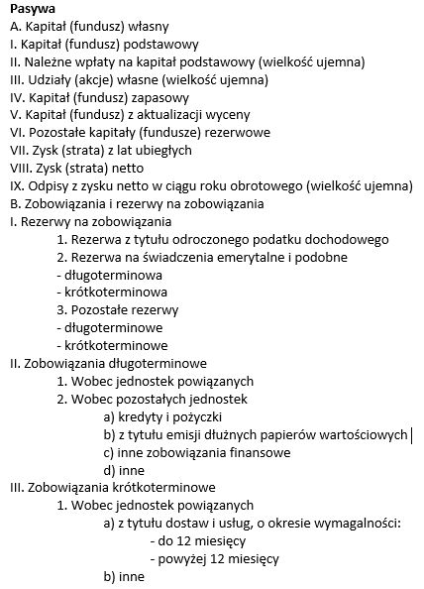

Bilans - pasywa
The accounting equation

Slide 7
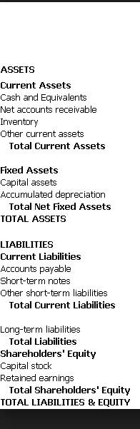
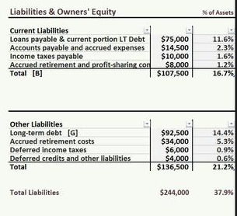
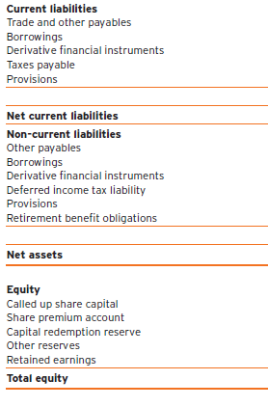
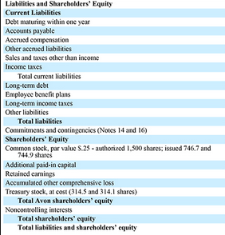
Balance sheet - ???

Slide 8
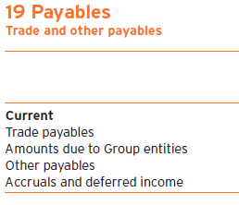
Rozwiązania – jak nazwać drugą stronę bilansu i jej niektóre pozycje
EQUITY AND LIABILITIES
A. EQUITY
B. LIABILITIES AND PROVISIONS
I. Provisions
II. Long-term liabilities
III. Short-term liabilities
1) Trade payables / accounts payable / trade creditors
(dopuszczalne, ale nie polecam)
LIABILITIES
A. EQUITY
B. LIABILITIES AND PROVISIONS
I. Provisions
II. Long-term liabilities
III. Short-term liabilities
1) Trade payables / accounts payable / trade creditors

Slide 9
Bilans – pasywa ciąg dalszy

Slide 10
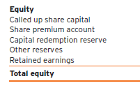
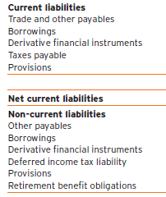
Balance sheet - Equity and liabilities
Reserves are any part of stockholders' equity, except for basic share capital. Reserves are amounts that are retained in the business and not distributed to the owners.
Reserves created from shareholders' contributions, the most common examples of which are:
legal reserve fund - it is required in many legislations and it must be paid as a percentage of share capital
share premium - amount paid by shareholders for shares in excess of their nominal value
Reserves created from profit, especially retained earnings. However, profits may be distributed also to other types of reserves, for example:
legal reserve fund from profit - many legislations require creation of the fund as a percentage of profits
remuneration reserve - will be used later to pay bonuses to employees or management.
translation reserve - arises during consolidation of entities with different reporting currencies
Provision: an amount set aside from profits in the accounts of an enterprise for a known liability, though the specific amount of the liability may not be known, or for the diminution of the value of an asset. Typical provisions include:
Restructuring Liabilities
Provisions for bad debts
Guarantees
Depreciation
Accruals
Pension

Slide 11
Rozliczenia międzyokresowe czynne i bierne, przychodów i kosztów
AKTYWA
…
V. Długoterminowe rozliczenia międzyokresowe
1. Aktywa z tytułu odroczonego podatku dochodowego
2. Inne rozliczenia międzyokresowe
IV. Krótkoterminowe rozliczenia międzyokresowe
PASYWA
…
IV. Rozliczenia międzyokresowe
1. Ujemna wartość firmy
2. Przychody przyszłych okresów
3. Inne rozliczenia międzyokresowe

Slide 12
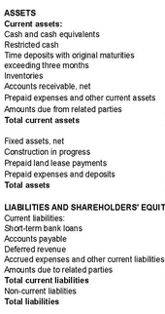
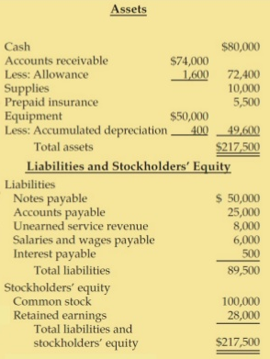
Accrued & deferred assets & liabilities
Prepaid expenses (current assets), such as rent, interest, insurance premium, etc. are future expenses that have been paid in advance. Deferred expense/charges (noncurrent assets) is e.g. bond issue costs.
Accrued revenues (or unrealized revenues, or accrued assets) are revenues earned by the seller for delivery of goods and services, for which the seller has not yet received payment.
An accrued expense is an expense that has been incurred, but for which there is not yet any expenditure documentation.
Unearned revenue (or advance payments, or deferred revenue) is cash received before the service or product is delivered (i.e. before revenue is earned).

Slide 13
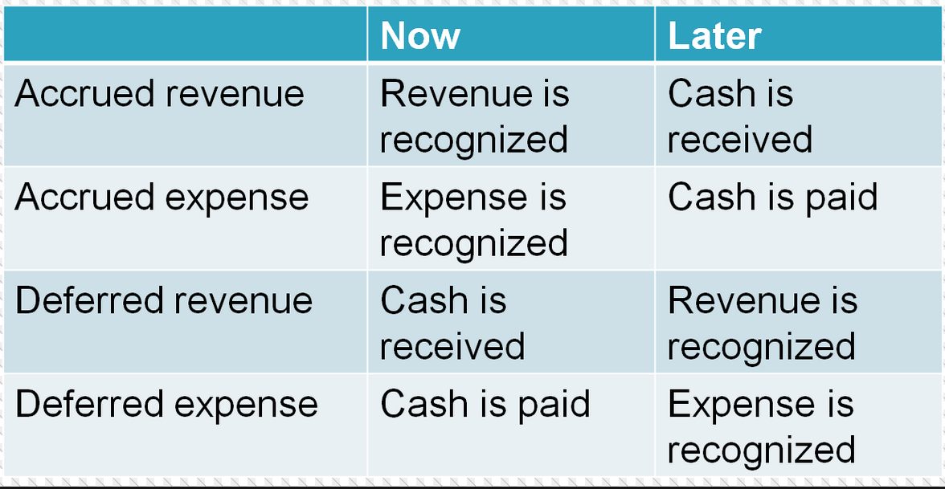
Simplest possible explanation

Slide 14
Deferred taxes
A deferred tax liability occurs when taxable income is smaller than the income reported on the income statements. This is a result of the accounting difference of certain income and expense accounts. This is only a temporary difference. The most common reason behind deferred tax liability is the use of different depreciation methods for financial reporting and the IRS.
A deferred tax asset is the opposite of a deferred tax liability. Deferred tax assets are reductions in future taxes payable, because the company has already paid the taxes on book income to be recognized in the future (like a prepaid tax).

Slide 15
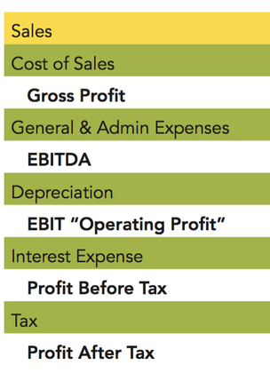
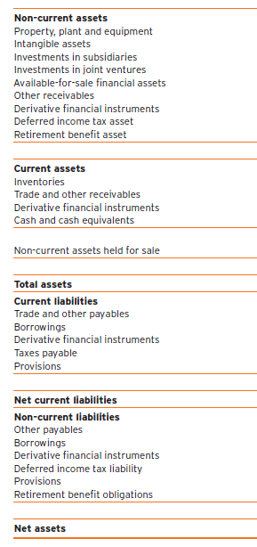
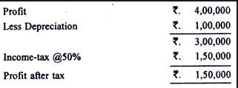

Netto – brutto 1

Slide 16
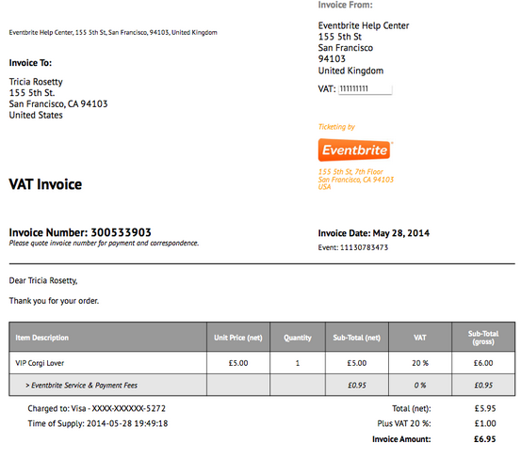
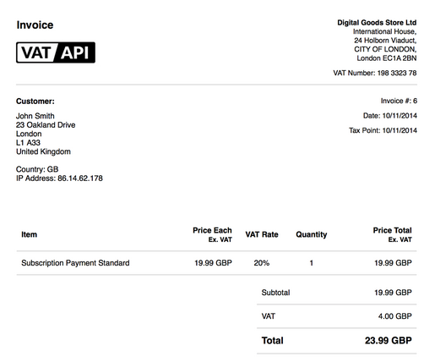
Netto – brutto 2

Slide 17
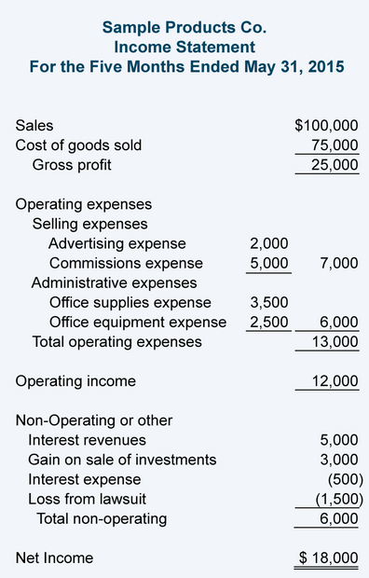
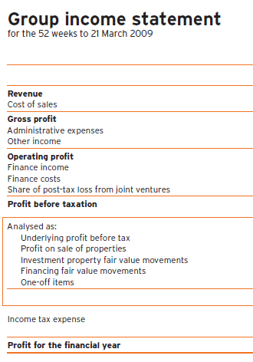
Przychód – dochód ≠ revenue – income 1

Slide 18
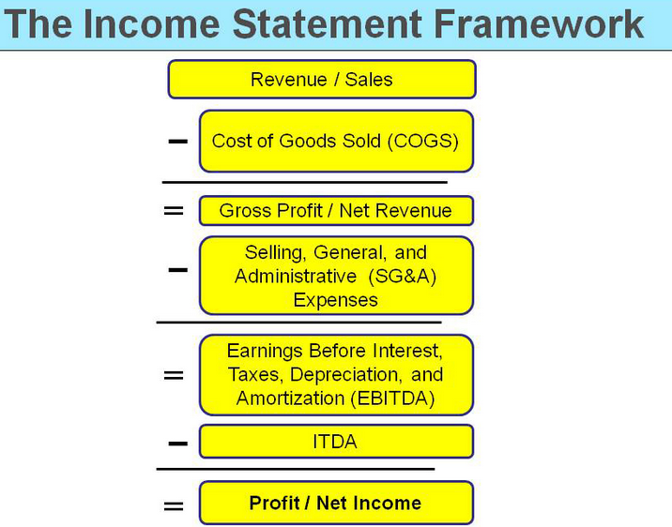
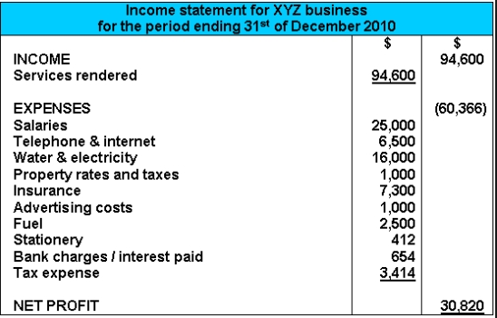
Przychód – dochód ≠ revenue – income 2

Slide 19
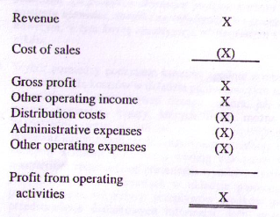
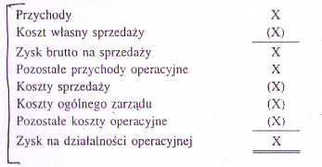
International Accounting Standards – Międzynarodowe Standardy Rachunkowości

Slide 20
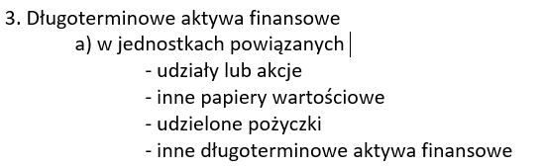
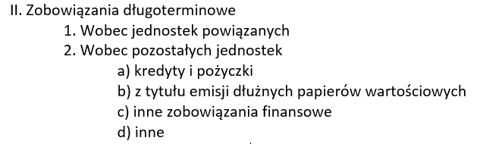
Kredyt - pożyczka

Slide 21
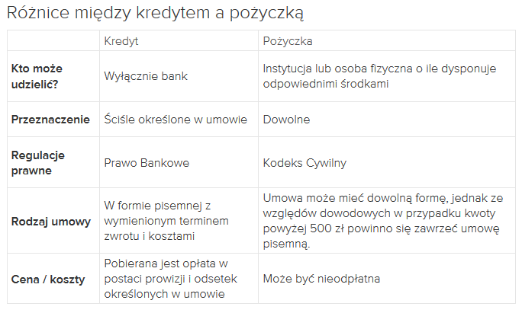
Kredyt – pożyczka ciąg dalszy

Slide 22
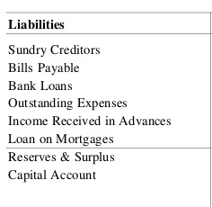
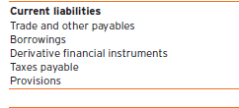
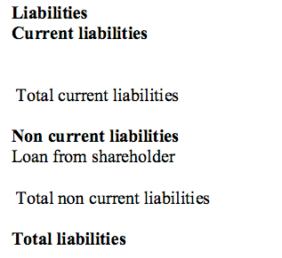
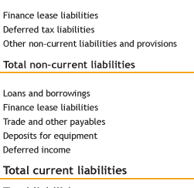
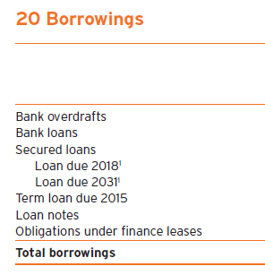
Loan – overdraft - credit

Slide 23
DZIĘKUJĘ ZA UWAGĘ

