Slide 1
Skąd czerpiemy wiedzę o rachunkowości?
Anna Setkowicz-Ryszka

Slide 2


Regulacje dotyczące rachunkowości obowiązujące w Polsce
Ustawa z dnia 29 września 1994 r. o rachunkowości
Rozporządzenia Ministra Finansów
Uchwały Komitetu Standardów Rachunkowości i Krajowej Rady Biegłych Rewidentów
Międzynarodowe standardy rachunkowości (MSR-IAS) i międzynarodowe standardy sprawozdawczości finansowej (MSSF-IFRS) oraz ich interpretacje
Prawo unijne - Rozporządzenie Komisji (WE) nr 1126/2008 z dnia 3.11.2008 r. przyjmujące określone międzynarodowe standardy rachunkowości zgodnie z rozporządzeniem (WE) nr 1606/2002 Parlamentu Europejskiego i Rady oraz Rozporządzenie Komisji (WE) Nr 1126/2008 z dnia 3.11.2008 przyjmujące określone międzynarodowe standardy rachunkowości zgodnie z rozporządzeniem (WE) nr 1606/2002 Parlamentu Europejskiego i Rady

Slide 3
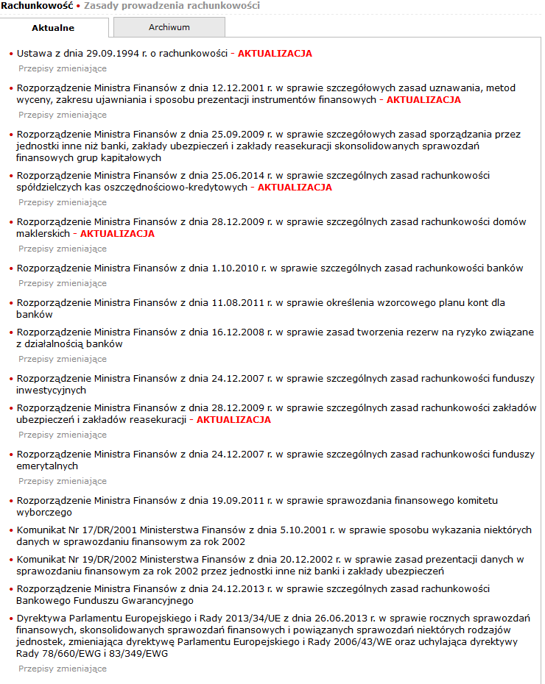
Akty prawne obowiązujące w Polsce (stan na 26.11.2015 r.)

Slide 4
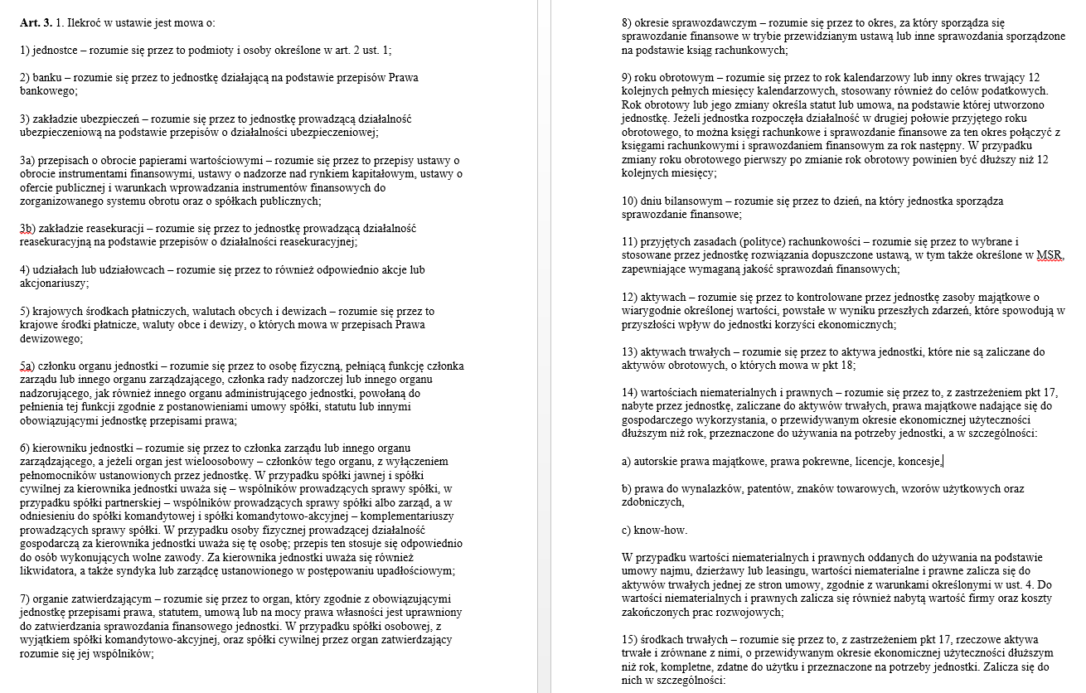
Ustawa o rachunkowości: definicje (artykuł 3)

Slide 5
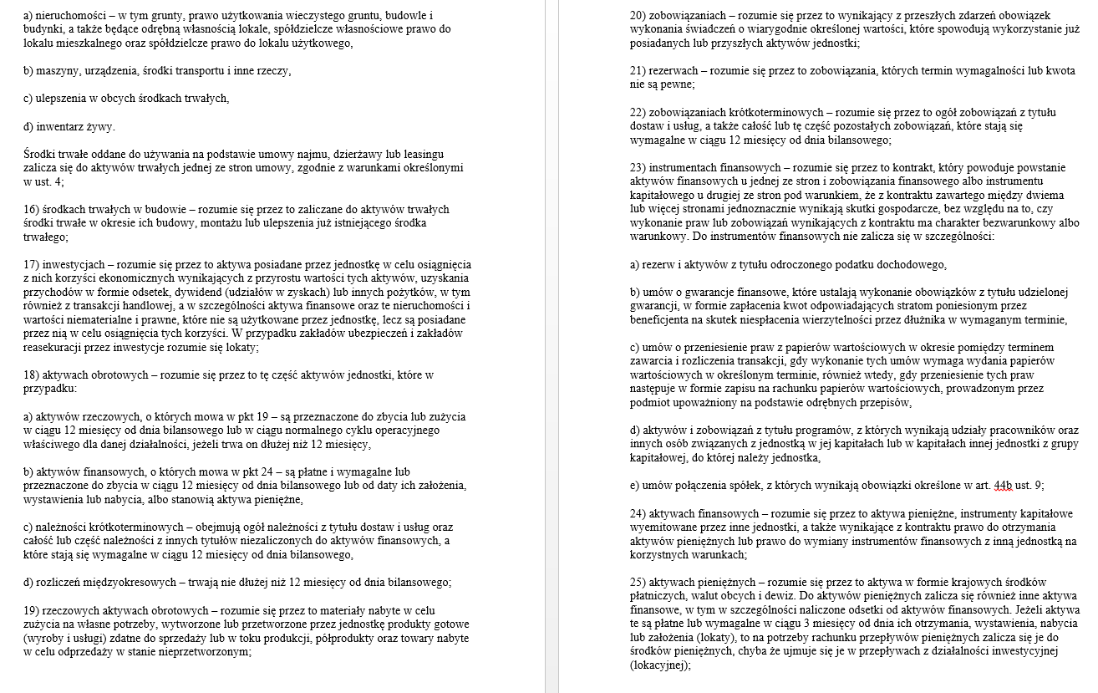
Ustawa o rachunkowości: definicje (artykuł 3)

Slide 6
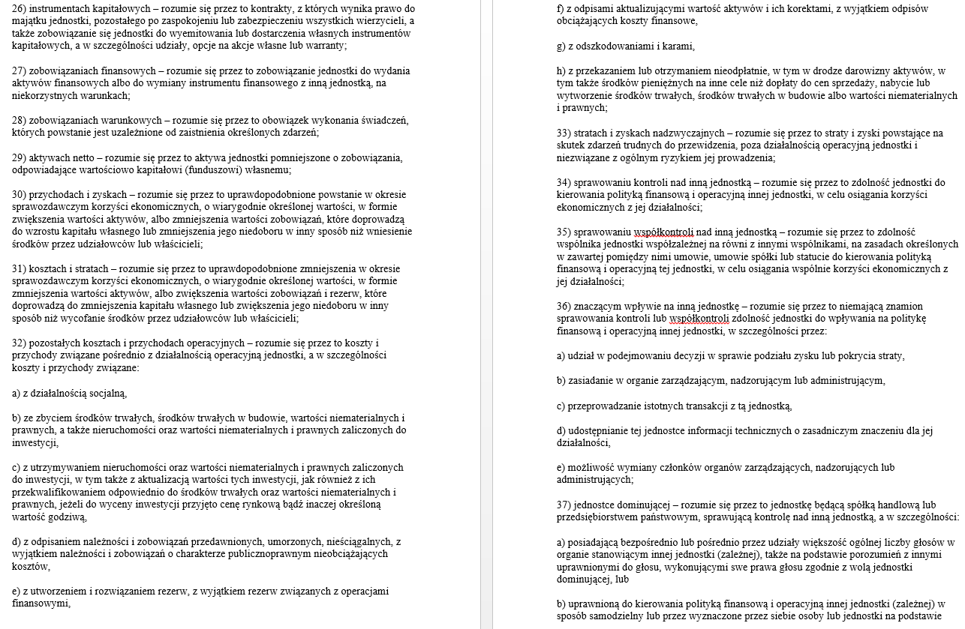
Ustawa o rachunkowości: definicje (artykuł 3)

Slide 7
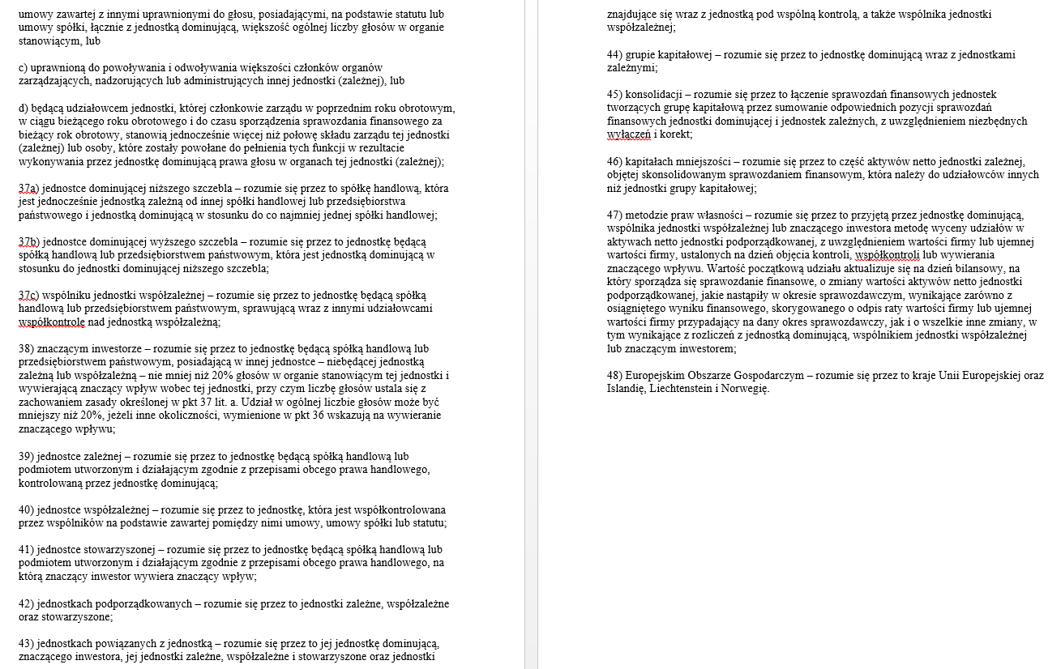
Ustawa o rachunkowości: definicje (artykuł 3)

Slide 8
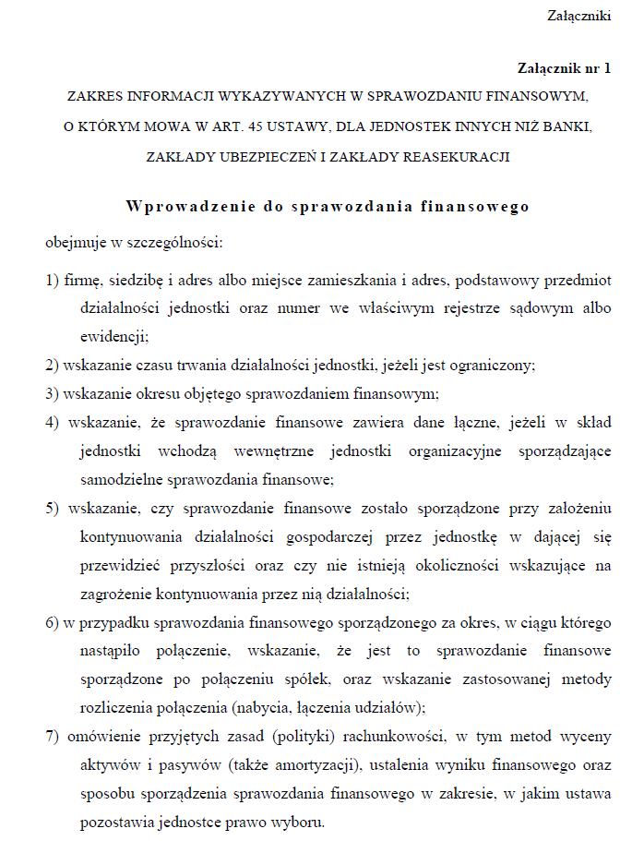
Ustawa o rachunkowości – początek Załącznika nr 1

Slide 9
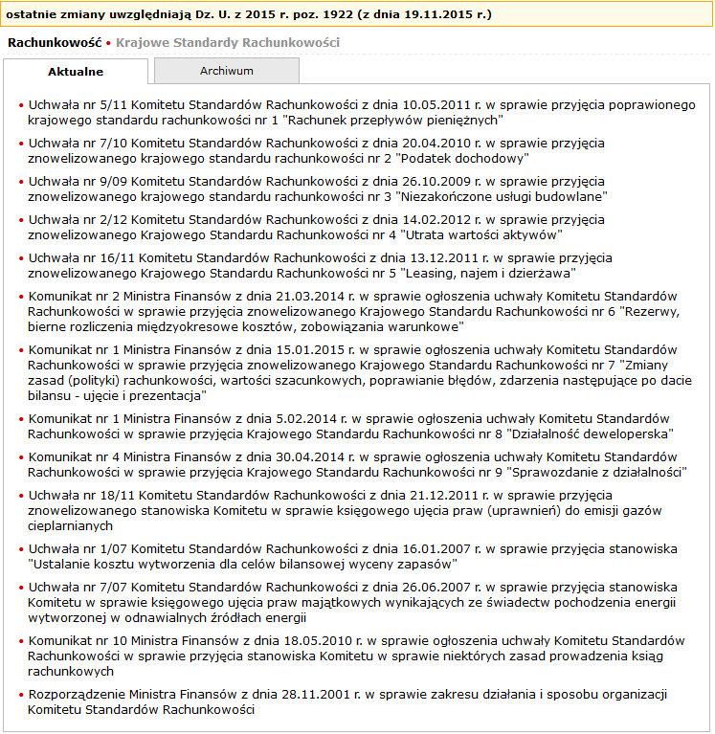

Slide 10
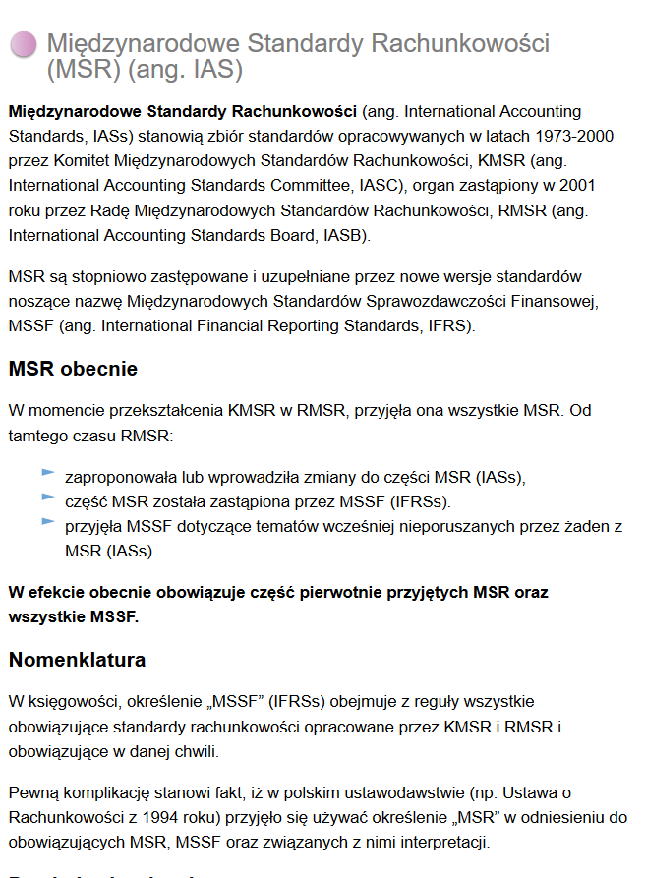
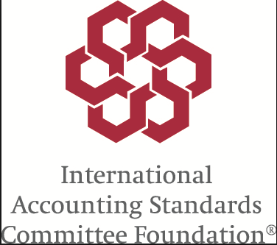
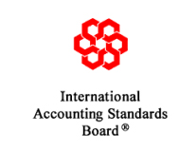
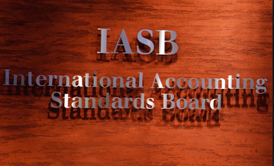


Slide 11
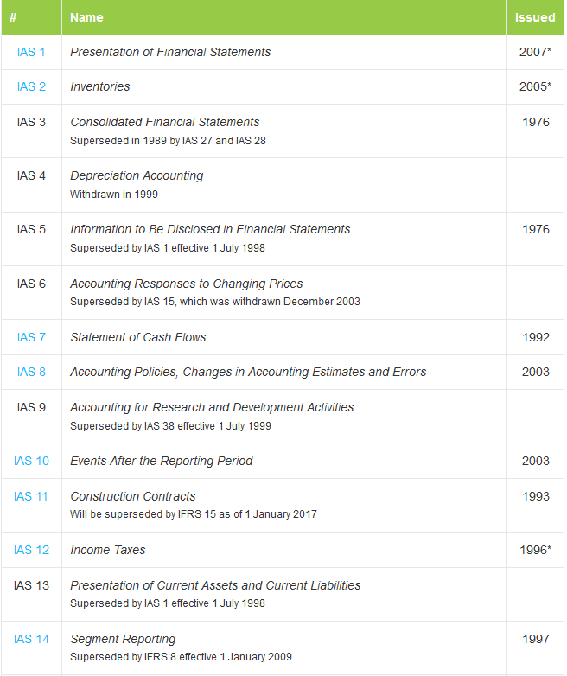

Slide 12
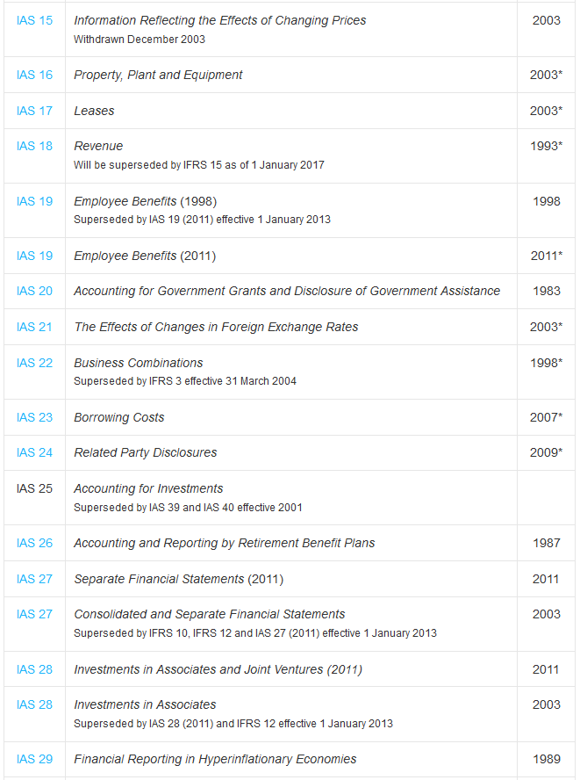

Slide 13
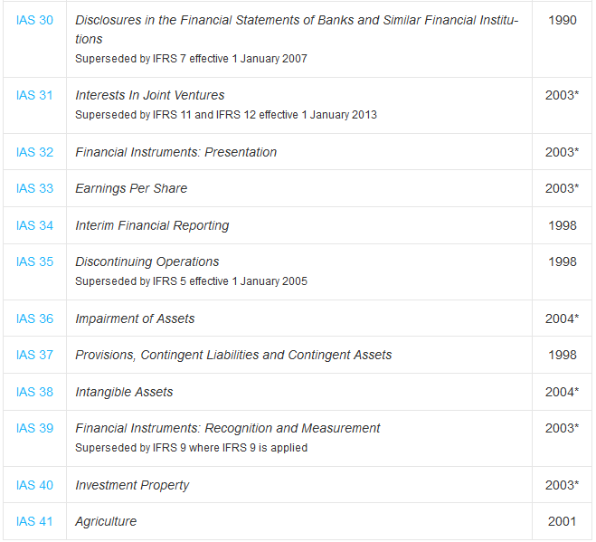

Slide 14
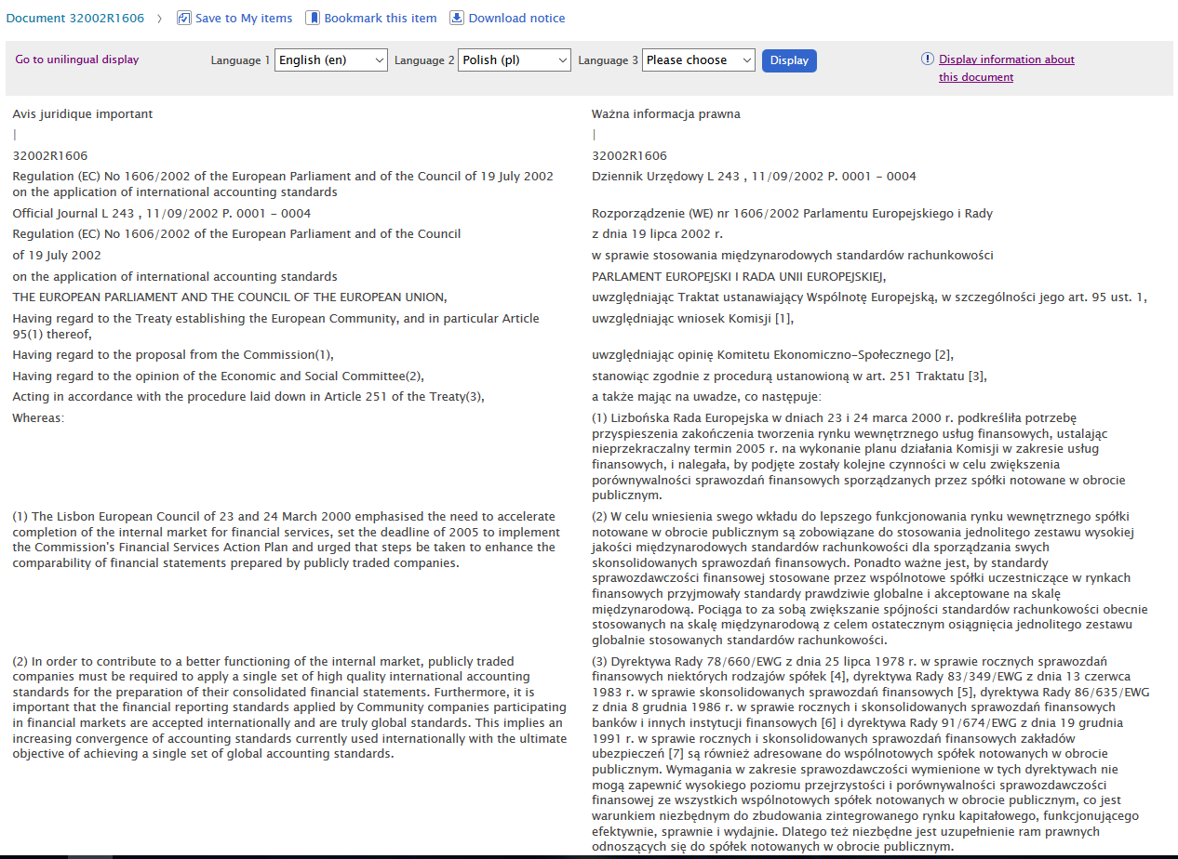


Slide 15
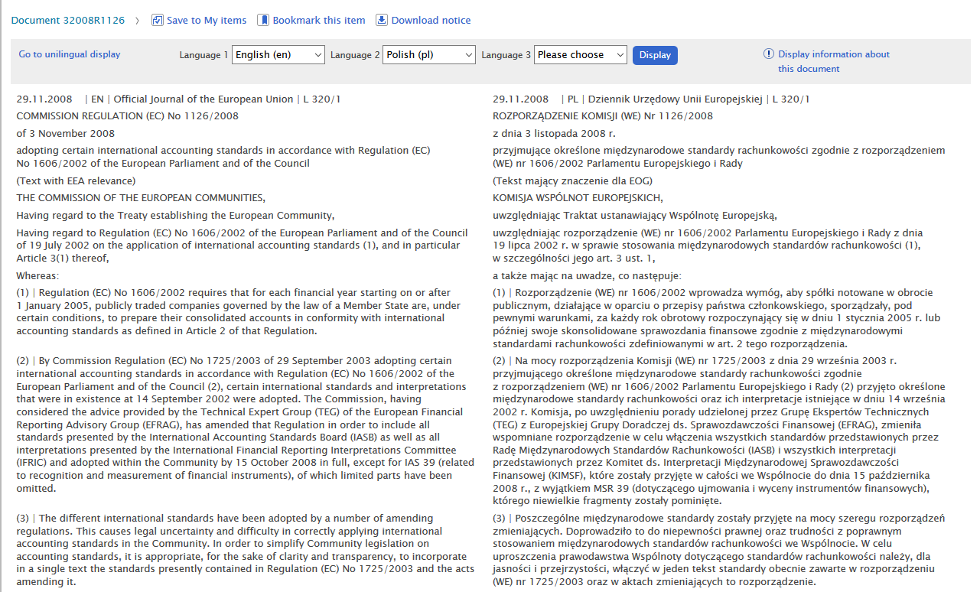


Slide 16
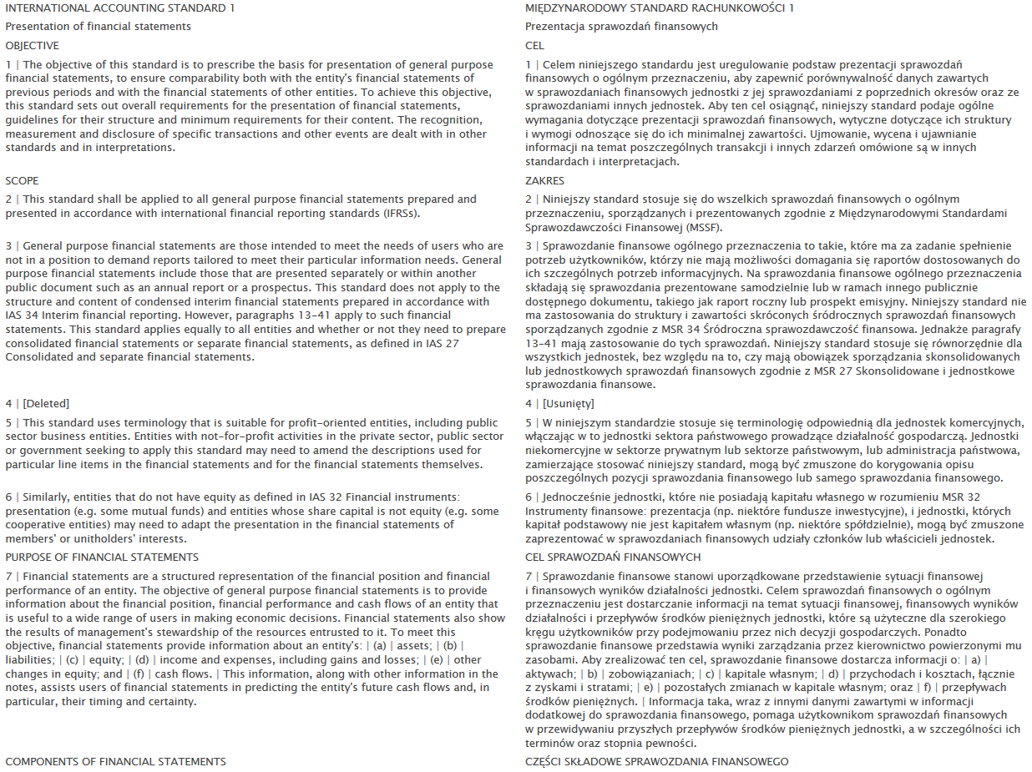


Slide 17
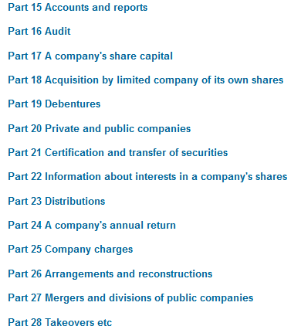
Regulacje dotyczące rachunkowości obowiązujące w Zjednoczonym Królestwie
Companies Act 2006 (http://www.legislation.gov.uk/ukpga/2006/46/contents)
UK GAAP:
- Financial Reporting Standards (FRS)
- Statements of Recommended Practice
(SORPs)
IASs, IFRSs, interpretations
Old UK GAAP

Slide 18

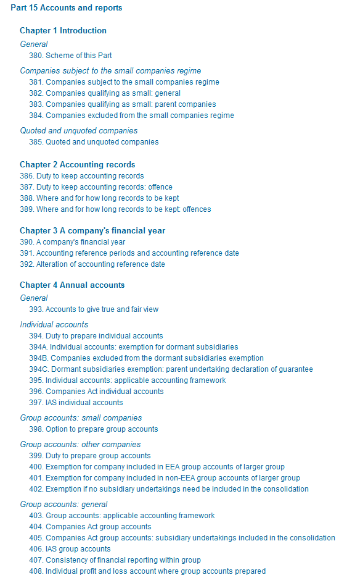
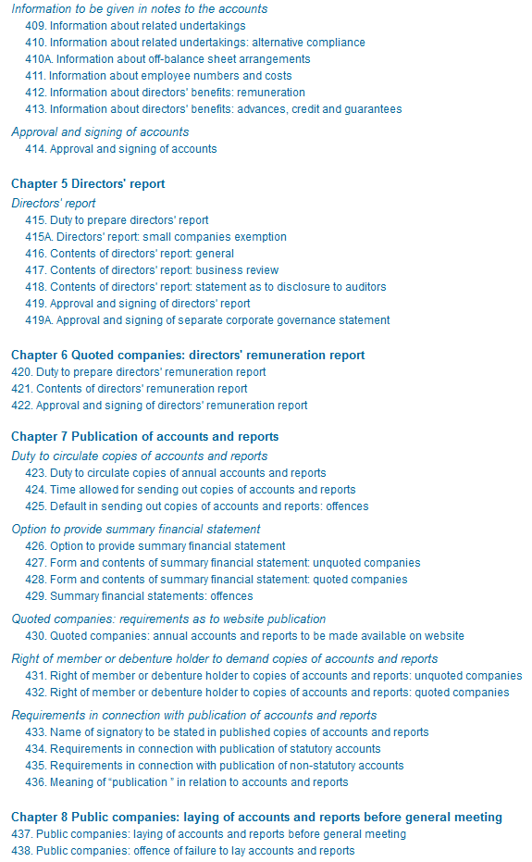

Slide 19
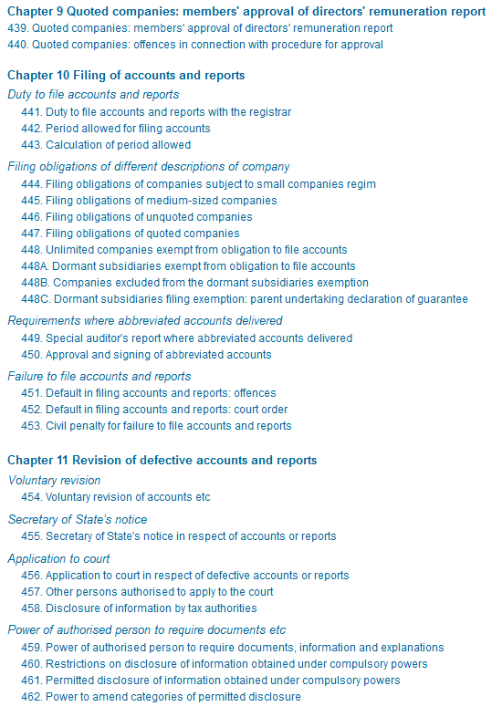
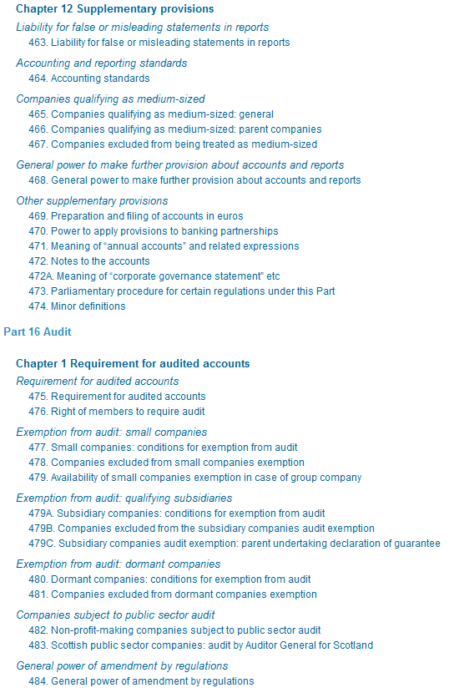


Slide 20
UK GAAP
Since 2005 listed groups in the UK have been required to prepare their consolidated financial statements in accordance with International Financial Reporting Standards (IFRSs). Almost all other groups and companies have a choice. They can choose to follow IFRSs or UK GAAP.
For periods beginning on or after 1 January 2015, three new Financial Reporting Standards (FRS 100, 101 and 102) will be in force, bringing with them a number of new options for all UK entities and groups. Those small entities that chose to apply the small entities regime and who currently apply the FRSSE will have to follow 'Section 1A Small Entities' within FRS 102 for accounting periods beginning on or after 1 January 2016. Micro-entities that currently apply the FRSSE will be able to apply FRS 105 if they qualify as micro entities from 1 January 2016.
The three new FRSs have been developed by the Accounting Standards Board (‘ASB', the predecessor of what is now the Accounting Council of the FRC) to replace Old UK GAAP and introduce an IFRS-based reduced disclosure framework for certain entities.
In addition to the above three standards, the Financial Reporting Council (FRC) issued another standard, FRS 103 Insurance Contracts in March 2014. FRS 103 contains specific accounting requirements for that have insurance contracts (including reinsurance contracts) and are applying FRS 102 ‘The Financial Reporting Standard applicable in the UK and Republic of Ireland’.
Companies who operate within specialised industries or sectors will also apply the requirements of their specific Statement of Recommended Practice (SORP) in conjunction with the Financial Reporting Standards. Most of the various SORP-issuing bodies have revised their SORPs in the light of FRS 102.
In March 2015 the FRC also issued FRS 104 Interim Financial Reporting, which is intended for use in the preparation of interim financial reports by those entities that apply FRS 102 but may also be used as a basis for preparing interim reports by those entities applying FRS 101 Reduced Disclosure Framework.

Slide 21
Old UK GAAP
Overview
Old UK GAAP (which can be found on FRC website) comprises a number of Financial Reporting Standards (FRSs), Statements of Standard Accounting Practice (SSAPs) and Urgent Issue Task Force (UITF) Abstracts. Each of the 30 FRSs and eight SSAPs currently in force includes requirements for a particular area of accounting, while the UITF Abstracts provide specific interpretations of accounting issues arising from application of the FRSs and SSAPs.
Scope
UK GAAP may be used by all UK groups and entities not required by law or regulation to apply EU-adopted IFRSs.
Entities other than companies may apply UK GAAP; often this is in conjunction with an applicable Statement of Recommended Practice (SORP).
Effective date
Existing UK GAAP will remain effective for periods commencing on or before 31 December 2014. For periods beginning on or after 1 January 2015, all previously effective FRSs, SSAPs, UITF Abstracts will be withdrawn and the requirements of New UK GAAP will become applicable.

Slide 22

Financial Reporting Council
Over­view
The Fin­an­cial Re­port­ing Council (FRC) is the UK’s reg­u­lator for the ac­count­ing, audit and ac­tu­ar­ial pro­fes­sions and is also re­spons­ible for cor­por­ate gov­ernance in the UK.
The FRC Board is re­spons­ible for the overall gov­ernance and strategy of the FRC and ul­ti­mately ap­proves all codes and stand­ards issued by the FRC. The chair and deputy chair are ap­poin­ted by the Sec­ret­ary of State for Busi­ness, In­nov­a­tion and Skills. Other Board members are ap­poin­ted by the Board. The Board is sup­por­ted by three gov­ernance com­mit­tees (the Audit, Re­mu­ner­a­tion and Nom­in­a­tions Com­mit­tees) and by the Ex­ec­ut­ive Com­mit­tee, the Conduct Com­mit­tee and the Codes and Stand­ards Com­mit­tee.

Slide 23
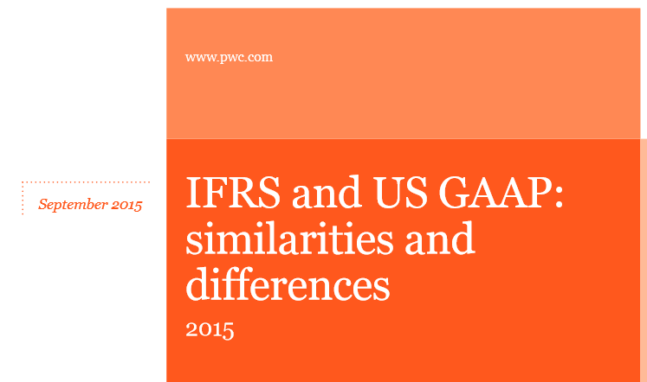
Regulacje dotyczące rachunkowości obowiązujące w Stanach Zjednoczonych
Generally Accepted Accounting Principles, also called GAAP or US GAAP, are the generally accepted accounting principles adopted by the U.S. Securities and Exchange Commission (SEC). While the SEC has stated that it intends to move from US GAAP to the International Financial Reporting Standards (IFRS), the latter differ considerably from GAAP and progress has been slow and uncertain.
http://www.pwc.com/us/en/cfodirect/assets/pdf/accounting-guides/pwc-ifrs-us-gaap-similarities-and-differences-2015.pdf

Slide 24
US GAAP
In the United States, GAAP derive, in order of importance, from:
issuances from an authoritative body designated by the American Institute of Certified Public Accountants (AICPA) Council (for example, the Financial Accounting Standards Board Statements, AICPA Accounting Principles Board Opinions, and AICPA Accounting Research Bulletins);
other AICPA issuances such as AICPA Industry Guides;
industry practice; and
into para-accounting literature in the form of books and articles.
! FASB Accounting Standards Codification (2009)

Slide 25
These organizations influence the development of GAAP in the United States (1):
United States Securities and Exchange Commission (SEC)
Created as a result of the Great Depression. At that time there was no structure setting accounting standards. The SEC encouraged the establishment of private standard-setting bodies through the AICPA and later the FASB, believing that the private sector had the proper knowledge, resources, and talents. The SEC works closely with various private organizations setting GAAP, but does not set GAAP itself.
American Institute of Certified Public Accountants (AICPA)
Committee on Accounting Procedure → Accounting Principles Board → Accounting Standards Executive Committee. AcSEC publishes:
Audit and Accounting Guidelines, which summarizes the accounting practices of specific industries (e.g. casinos, colleges, airlines, etc.) and provides specific guidance on matters not addressed by FASB or GASB.
Statements of Position, which provides guidance on financial reporting topics until the FASB or GASB sets standards on the issue.
Practice Bulletins, which indicate the AcSEC's views on narrow financial reporting issues not considered by the FASB or the GASB.

Slide 26
These organizations influence the development of GAAP in the United States (2):
Financial Accounting Standards Board (FASB)
This structure is composed of three organizations: the Financial Accounting Foundation (FAF, it selects members of the FASB, funds and oversees their activities), the Financial Accounting Standards Advisory Council (FASAC), and the major operating organization in this structure the Financial Accounting Standards Board (FASB). FASB has 4 major types of publications:
Statements of Financial Accounting Standards - the most authoritative GAAP setting publications. More than 150 have been issued to date.
Statements of Financial Accounting Concepts - They are part of the FASB's conceptual framework project and set forth fundamental objectives and concepts that the FASB use in developing future standards. However, they are not a part of GAAP. There have been 7 concepts published to date.
Interpretations - modify or extend existing standards. There have been around 50 interpretations published to date.
Technical Bulletins - guidelines on applying standards, interpretations, and opinions. Usually solves some very specific accounting issue that will not have a significant, lasting effect.

Slide 27
These organizations influence the development of GAAP in the United States (3):
Governmental Accounting Standards Board (GASB)
Created in 1984, the GASB addresses state and local government reporting issues. Its structure is similar to that of the FASB's.
Other influential organizations: The Government Finance Officer's Association (GFOA) also influences financial policies for governments (disagreements between the GFOA and GASB are rare, but can continue for many years); American Accounting Association, Institute of Management Accountants, Financial Executives Institute.

Slide 28
Uwaga: pomoc z MF
http://www.mf.gov.pl/documents/764034/1399171/Glosariusz+SPPW+-Rachunkowosc.pdf

